Slide 1
WELCOME!
PEIP (PUBLIC EMPLOYEES INSURANCE PROGRAM)
2025 GROUP MEDICARE RENEWAL
October 2024
Blue Cross® and Blue Shield® of Minnesota and Blue Plus® are nonprofit independent licenses of the Blue Cross and Blue Shield Association.
We do not offer every plan available in your area. Any information we provide is limited to those plans we do offer in your area. Please contact Medicare.gov or 1-800-MEDICARE to get information on all of your options
S5743_091923_P01_M Y0138_091923_P01_M

Slide 2
TODAY’S TOPICS
Group Medicare coverage for PEIP (Public Employees Insurance Program)
2025 Renewal updates
Important Resources
Costs shown are the amounts members pay. *The amount you spend on supplemental drugs does not apply toward catastrophic coverage.
2

Slide 3
PUBLIC EMPLOYEES INSURANCE PROGRAM GROUP MEDICARE COVERAGE
GROUP MEDICARE PLAN OPTIONS
MEDICARE ADVANTAGE PLANS | MEDICARE COST PLANS | PART D PRESCRIPTION DRUG COVERAGE
Group Medicare Advantage Select Rx 2 MAPD (PPO) Integrated medical plan and Medicare Part D coverage | Group Platinum Blue Plan C | Group MedicareBlue Rx (PDP) Choice of Part D drug plans: Option 1: $10/$25/$60/25% Option 2: $5?410/20%/40%/33%
Costs shown are the amounts members pay. *The amount you spend on supplemental drugs does not apply toward catastrophic coverage.
3

Slide 4
GROUP MEDICARE ADVANTAGE PLAN
4

Slide 5
GROUP MEDICARE ADVANTAGE
Eligibility requirements
RETIREE
Be identified as an eligible plan participant by your employer
Be entitled to Medicare Part A and enrolled in Medicare Part B
Continue to pay Part B premium
Must be a permanent resident of the United States or United States territories
EMPLOYER GROUP / UNION
Must be headquartered in Minnesota
Costs shown are the amounts members pay. *The amount you spend on supplemental drugs does not apply toward catastrophic coverage.
5

Slide 6
GROUP MEDICARE ADVANTAGE
Plan highlights
Access to 97% of doctors in Minnesota¹
National provider access to any Medicare contracted provider that accepts Medicare assignment
Extras and options not covered by Medicare
No referrals needed
Worldwide emergency and urgent care benefits
•
Combined medical and drug coverage (Part D) for
convenience of one plan, one card, one bill
Fill your prescriptions at thousands of in-network pharmacies nationwide
Annual contract plans
•
2
²Medicare-contracted doctors compared to internal Blue Cross and Blue Shield of Minnesota data, April 2024. Some network limitations may apply.
Costs shown are the amounts members pay. *The amount you spend on supplemental drugs does not apply toward catastrophic coverage.
6

Slide 7
MEDICARE ADVANTAGE
MEDICARE ADVANTAGE
Plan extras
PHYSICAL EXAM
$0 copay for 1 exam
SILVERSNEAKERS®
50+ fitness classes and on-demand workout videos, workshops and online classes — all at no additional cost
OVER-THE-COUNTER
$50 quarterly balance for eligible over-the-counter purchases*
CHIROPRACTIC
12 routine visits; any diagnosis (X-ray excluded)
DENTAL- MAPD only
Preventive dental
ACUPUNCTURE
12 visits for pain
VISION
$0 copay for 1 routine exam plus $200 annual eyewear benefit for non-Medicare covered eyewear
MEALS
28 meals provided at no cost after an approved inpatient stay
HEARING
$0 copay on exams, $499 copay (Advanced Aid), $799 copay (Premium) per hearing aid
DIABETES PREVENTION
Diabetes and heart disease prevention with online education, health coaching and peer groups
.
PEER SUPPORT SPECIALIST
$0 copay for substance abuse disorders or mental illness
*Quarterly balance does not carry over.
^{Co}S^{sts}ilv^{sh}eºr^{w}S^{n} n^{ar}e^{e} a^{th}k^{e}e^{am}rs^{o®un}i^{t}s^{s m}a^{em}re^{be}g^{r}i^{s}s^{p}tªe^{y}r. e^{*T}d^{he}trªa^{m}dºe^{un}m^{t y}a^{ou}rk^{sp}o^{en}f^{d}Tºi^{n}v^{s}it^{u}y^{pp}H^{lem}e^{e}a^{n}l^{t}tªh^{l d},^{r}I^{u}n^{gs}c^{d}.,^{oe}a^{s}n^{no}i^{t}nªd^{pp}e^{ly}p^{t}e^{ow}nªd^{rd}e^{c}n^{at}tªc^{st}o^{ro}m^{phi}p^{c} a^{co}n^{v}y^{era}t^{g}h^{e}a. t provides health and fitness programs.
7

Slide 8
2025 GROUP MEDICARE ADVANTAGE PLAN:
Preventive Dental: Classic with Rx 1
Dental Services
2 exams | $0
4 routine cleanings or periodontal cleanings
1 set of X-rays
2 fluoride treatments
NATIONAL NETWORK OF PROVIDERS
$1,000 ANNUAL PLAN MAXIMUM
Costs shown are the amounts members pay. *The amount you spend on supplemental drugs does not apply toward catastrophic coverage.
8

Slide 9
GROUP MEDICARE ADVANTAGE SELECT (MAPD-PPO)
 | GROUP MEDICARE ADVANTAGE SELECT
Prescription drug option | Rx Option 2
Deductible | $0
Annual out-of-pocket maximum | $3,000 in-network $3,000 combined
Office visit (Primary care) | $0 copay
Specialist visit | $20 copay
Preventive services* | $0
Inpatient hospital | $150 copay per stay
Emergency | $50 copay
Urgent care | $20 copay
Outpatient hospital surgery | $75 copay
Diabetic supplies (test strips and meters through Ascensia) | $0
Costs shown are the amounts members pay. *The amount you spend on supplemental drugs does not apply toward catastrophic coverage.
9

Slide 10
GROUP MEDICARE ADVANTAGE
Rx Option 2
PAIR WITH MEDICAL PLAN: CLASSIC OR SELECT | RX OPTION 2
Deductible | $0
Tier 1: Preferred generic drugs | $0
Tier 2: Generic drugs | $10 copay
Tier 3: Preferred brand drugs | $25 copay
Tier 4: Non-preferred drugs | $60 copay
Tier 5: Specialty drugs | 25% coinsurance
Catastrophic coverage Amount you pay after annual out-of-pocket prescription drug costs reach $2,000 | During this payment stage, the plan pays the full cost for your covered Part D drugs. You pay nothing. For excluded drugs covered under the Bonus drug list, you pay 25% coinsurance.
Supplemental Drug Coverage | 25% coinsurance
Costs shown are the amounts members pay. *The amount you spend on supplemental drugs does not apply toward catastrophic coverage.
10

Slide 11
GROUP MEDICARE ADVANTAGE MEMBER RESOURCES
ONLINE
Visit bluecrossmn.com to:
View claim history
Find in-network doctors and hospitals
Find quality ratings for doctors and other providers
Send secure emails to customer service
CUSTOMER SERVICE
Call 1-800-711-9865 (TTY 711)
Monday through Friday,
8 a.m. to 8 p.m.*, Central Time
Costs shown are the amounts members pay. *The amount you spend on supplemental drugs does not apply toward catastrophic coverage.
11

Slide 12
GROUP PLATINUM BLUE (COST PLAN)
12

Slide 13
GROUP PLATINUM BLUESM
Eligibility requirements*
RETIREE
Have Medicare Part A and/or Part B
Continue to pay Part B premium
Be a permanent resident of Minnesota
Reside in plan’s service area
EMPLOYER GROUP / UNION
Must be headquartered in Minnesota
Costs shown are the amounts members pay. *The amount you spend on supplemental drugs does not apply toward catastrophic coverage.
13

Slide 14
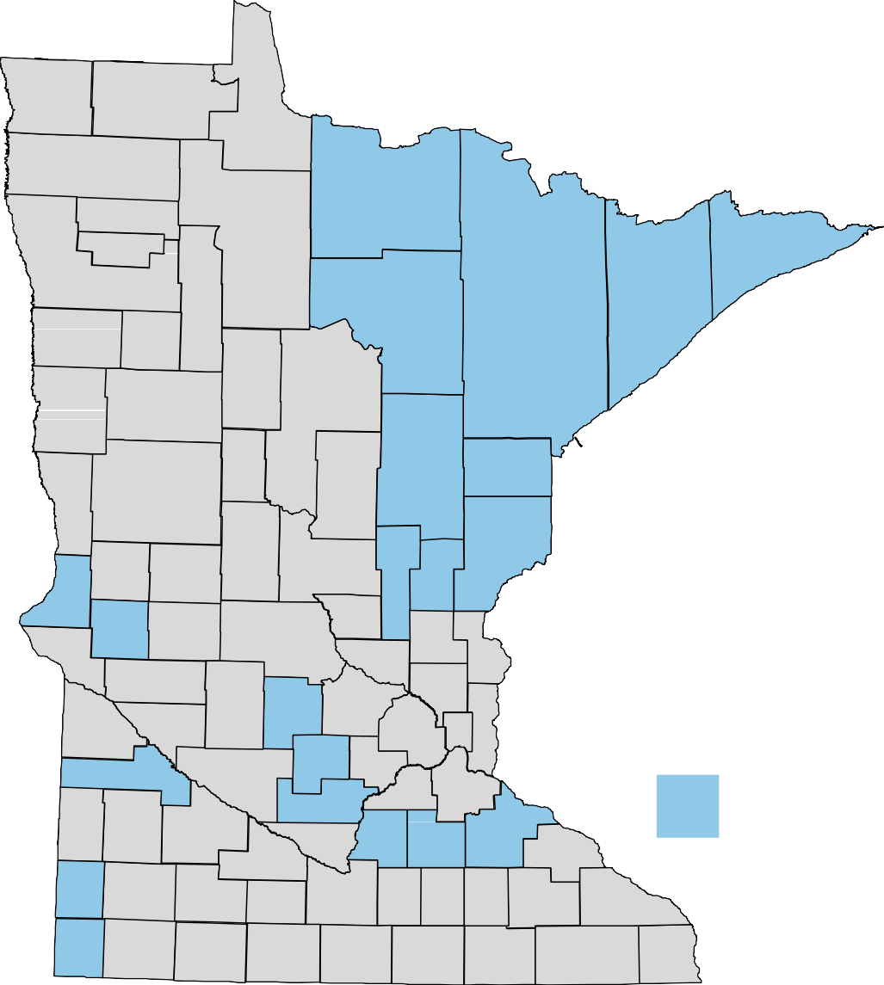
GROUP PLATINUM BLUESM (COST)
Availability area
Aitkin
Carlton
Cook
Goodhue
Itasca
Kanabec
Koochiching
Lake
Le Sueur
McLeod
Meeker
Mille Lacs
Pine
Pipestone
Rice
Rock
Sibley
St. Louis
Stevens
Traverse
Yellow Medicine
Platinum Blue available in these counties
Costs shown are the amounts members pay. *The amount you spend on supplemental drugs does not apply toward catastrophic coverage.
14

Slide 15
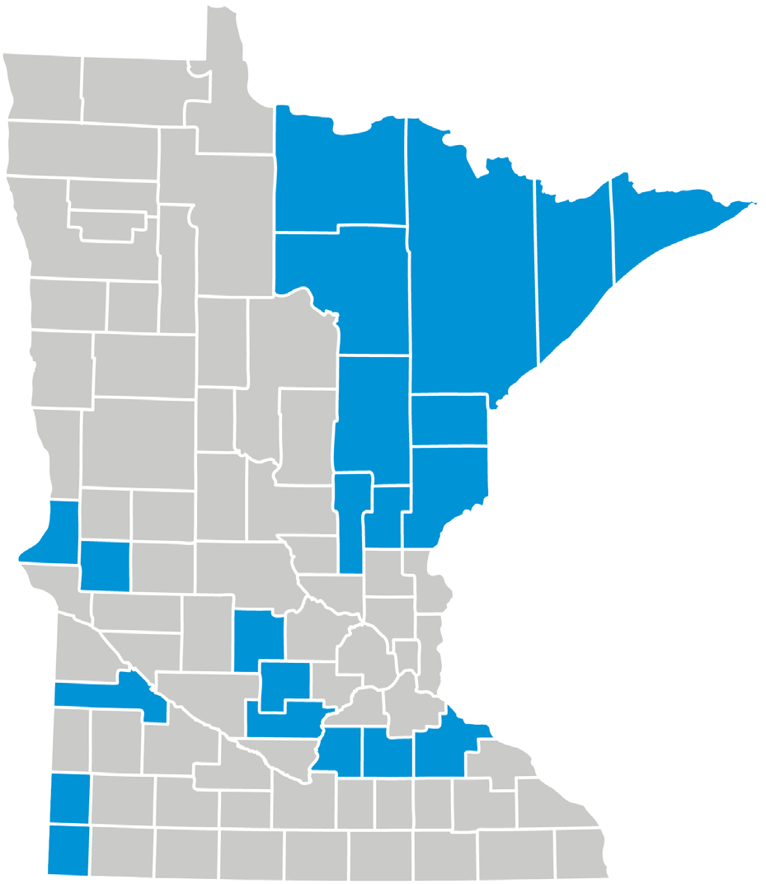
PLATINUM BLUE
Plan highlights
FEATURES OF THIS PLAN
Provides extras not covered by Medicare
Large access network (statewide and U.S.)
No referrals needed
Nationwide travel up to nine consecutive months and access to in-network providers and prescription support
Worldwide emergency benefits
Annual contract plan
Available to residents of the Northeast Plus Region
Costs shown are the amounts members pay. *The amount you spend on supplemental drugs does not apply toward catastrophic coverage.
15

Slide 16
PLATINUM BLUE
Plan extras
PHYSICAL EXAM
$0 copay for 1 exam
SILVERSNEAKERS®
Fitness program: 600+ participating locations in Minnesota, virtual classes
OVER-THE-COUNTER
$50 per quarter balance for eligible over-the-counter purchases*
CHIROPRACTIC
12 routine visits; any diagnosis (X-ray excluded)
VISION
$0 copay for 1 routine exam plus $200 annual eyewear benefit for non-Medicare covered eyewear
ACUPUNCTURE
12 visits for pain
DIABETES PREVENTION
Diabetes and heart disease prevention with online education, health coaching and peer groups
HEARING
$0 copay on exams, $499 copay (Advanced Aid), $799 copay (Premium) per hearing aid
*Quarterly balance does not carry over.
SilverSneakers® is a registered trademark of Tivity Health, Inc., an independent company that provides health and fitness programs.
16
Costs shown are the amounts members pay. *The amount you spend on supplemental drugs does not apply toward catastrophic coverage.

Slide 17
GROUP PLATINUM BLUESM
Plan C Medical coverage
BENEFITS | COST
Deductible | $0
Office visits | $20 copay
Preventive services | $0
Inpatient hospital care | $200 copay per stay
Emergency | $50 copay
Urgent care | $20 copay
Durable medical equipment (DME) | 20% coinsurance
Over-the-counter benefit | $50 per quarter
Annual out-of-pocket maximum | $3,000
Costs shown are the amounts members pay. *The amount you spend on supplemental drugs does not apply toward catastrophic coverage.
17

Slide 18
GROUP PLATINUM BLUESM MEMBER RESOURCES
ONLINE
Visit bluecrossmn.com to:
View claim history
Find in-network doctors and hospitals
Find quality ratings for doctors and other providers
Send secure emails to customer service
CUSTOMER SERVICE
Call 1-866-340-8654 (TTY 711)
Monday through Friday,
8 a.m. to 8 p.m.*, Central Time
Costs shown are the amounts members pay. *The amount you spend on supplemental drugs does not apply toward catastrophic coverage.
18

Slide 19
GROUP MEDICAREBLUE RX (PDP)
19

Slide 20
GROUP MEDICAREBLUESM RX (PDP)
Eligibility requirements
RETIREE
EMPLOYER GROUP / UNION
Must be headquartered in Minnesota
Be identified as an eligible plan participant by your employer
Be entitled to Medicare benefits under Part A and /or enrolled in Medicare Part B
Continue to pay your Part B premium
Live in the plan’s service area
You are a U.S. citizen or lawfully present in the U.S.
Please note: May only be enrolled in one Part D plan at any time
Costs shown are the amounts members pay. *The amount you spend on supplemental drugs does not apply toward catastrophic coverage.
20

Slide 21
GROUP MEDICAREBLUESM RX
Prescription drug coverage
FEATURES
Stand-alone Medicare Part D plan
Helps pay for generic and brand-name drugs
[Includes some coverage for supplemental drugs]
Offers a 90-day supply for two copay
Fill your prescription at participating network pharmacies across the U.S., including independent pharmacies, national chains and more
No deductible
The formulary meets federal regulations.
Supplemental drug coverage includes select drugs excluded from the Medicare Part D program.
: The formulary meets federal regulations. Supplemental drug coverage includes select drugs excluded from the Medicare Part D program
Costs shown are the amounts members pay. *The amount you spend on supplemental drugs does not apply toward catastrophic coverage.
21

Slide 22
GROUP MEDICAREBLUESM RX
$10 / $25 / $60 / 25%- OPTION 1
Paired with Group Platinum Blue only | 30-day Supply from a Network Pharmacy or 31-day Supply from a Long-Term Care Facility | 90-day Supply from a Network Pharmacy or Mail Order
Tier 1: Generic drugs | $10 copay | $20 copay
Tier 2: Preferred brand drugs | $25 copay | $50 copay
Tier 3: Non-Preferred brand drugs | $60 copay | $120 copay
Tier 4: Specialty drugs | 25% coinsurance | 25% coinsurance
Catastrophic coverage Amount you pay after annual out-of-pocket prescription drug costs reach $2,000 | During this payment stage, the plan pays the full cost for your covered Part D drugs. You pay nothing. For excluded drugs covered under our Supplemental drug list, you pay 25% coinsurance.
Supplemental drugs* | 25% coinsurance | 25% coinsurance
Costs shown are the amounts members pay.
*The amount you spend on supplemental drugs does not apply toward catastrophic coverage.
22

Slide 23
GROUP MEDICAREBLUESM RX
$5/$10/20%/45%/33%- OPTION 2
Paired with Group Platinum Blue only | 30-day Supply from a Network Pharmacy or 31-day Supply from a Long-Term Care Facility | 90-day Supply from a Network Pharmacy or Mail Order
Tier 1: Preferred Generic drugs | $5 copay | $10 copay
Tier 2: Generic drugs | $10 copay | $20 copay
Tier 3: Preferred brand drugs | 20% coinsurance | 20% coinsurance
Tier 4: Non-Preferred drugs | 45% coinsurance | 45% coinsurance
Tier 5: Specialty drugs | 33% coinsurance | 33% coinsurance
Catastrophic coverage Amount you pay after annual out-of-pocket prescription drug costs reach $2,000 | During this payment stage, the plan pays the full cost for your covered Part D drugs. You pay nothing.
Supplemental drugs* | Not covered | Not covered
Costs shown are the amounts members pay.
*The amount you spend on supplemental drugs does not apply toward catastrophic coverage.
23

Slide 24
IF YOUR DRUG IS NOT ON THE FORMULARY
TALK TO YOUR DOCTOR
He or she can review the formulary and prescribe a similar drug for your condition
REQUEST A
FORMULARY EXCEPTION
If other drugs won’t be as effective, your doctor can ask the plan to cover the drug
REQUEST A TRANSITION SUPPLY
You can request up to a 30-day transition supply during your first 90 days of membership
Costs shown are the amounts members pay. *The amount you spend on supplemental drugs does not apply toward catastrophic coverage.
24

Slide 25
GROUP MEDICAREBLUESM RX
Diabetic supply coverage
PART B MEDICAL INSURANCE
Strips
Machines
Calibration solutions
Lancets
PART D PRESCRIPTION DRUG BENEFIT
Syringes
Insulin
Needles
Alcohol swabs
Costs shown are the amounts members pay. *The amount you spend on supplemental drugs does not apply toward catastrophic coverage.
25

Slide 26
GROUP MEDICAREBLUESM RX MEMBER RESOURCES
ONLINE
Visit YourMedicareSolutions.com/ GroupPlans
to see:
Forms
Formulary
Pharmacy locator
CUSTOMER SERVICE
Call 1-877-838-3827 (TTY 711)
daily, 8 a.m. to 8 p.m.*, Central and Mountain Times
Costs shown are the amounts members pay. *The amount you spend on supplemental drugs does not apply toward catastrophic coverage.
26

Slide 27
2025 PLAN UPDATES AND RATES
27

Slide 28
2025 UPDATES
GROUP PLATINUM BLUE
Plans | Benefit | Current | 2025
All | Plan benefit allowance for non-Medicare covered eyewear every year | $150 | $200
All | Omada for diabetes and hypertension | Not available | Available
2025 UPDATES
GROUP MEDICAREBLUE RX
Elimination of Coverage Gap
Catastrophic threshold is $2,000
Medicare Prescription Payment Plan (copay smoothing)
Costs shown are the amounts members pay. *The amount you spend on supplemental drugs does not apply toward catastrophic coverage.
28

Slide 29
2025 GROUP MEDICARE RENEWAL PUBLIC EMPLOYEES INSURANCE PROGRAM
Group Medicare Advantage Select Rx 2 | 2025
Medical | $139.50
Medicare Part D $0/$10/$25/$60/25% | $140.50
Total monthly premium per member | $280.00
29

Slide 30
2025 GROUP MEDICARE RENEWAL PUBLIC EMPLOYEES INSURANCE PROGRAM
Group Platinum Blue Plan C with Group MedicareBlue Rx (PDP) Option 1 | 2025
Group Medicare Platinum Blue Plan C | $118.50
Group MedicareBlue RX (PDP) $10/$25/$60/25% | $203.50
Total monthly premium per member | $322.00
Group Platinum Blue Plan C with Group MedicareBlue Rx (PDP) Option 2 | 2025
Group Medicare Platinum Blue Plan C | $118.50
Group MedicareBlue RX (PDP) $5/$10/20%/45%/33% | $175.00
Total monthly premium per member | $293.50
30

Slide 31
OTHER USEFUL RESOURCES
BLUE CROSS AND BLUE SHIELD OF MINNESOTA
1-877-311-0404, TTY 711,
8 a.m. to 8 p.m. Central Time, Daily
bluecrossmn.com YourMedicareSolutions.com bluecrossmn.com/advisors
SENIOR LINKAGE LINE®
1-800-333-2433
TTY 711
seniorlinkageline.com
SOCIAL SECURITY
1-800-772-1213
TTY 1-800-325-0778
8 a.m. to 7 p.m., Monday – Friday
ssa.gov
MEDICARE HELPLINE
7 days a week, 24 hours a day
1-800-633-4227
TTY 1-877-486-2048
medicare.gov
Costs shown are the amounts members pay. *The amount you spend on supplemental drugs does not apply toward catastrophic coverage.
31

Slide 32
#1 MEDICARE ADVANTAGE PLAN CHOSEN BY MINNESOTANS¹
Access to 97% of doctors in Minnesota²
Local expertise supporting Medicare since it began⁵
Nearly 95% of members keep their Blue Cross Medicare plan³
Serving Minnesota as a nonprofit
for more than 90 years⁵
Top-rated by members for Medicare customer service⁴
Costs shown are the amounts members pay. *The amount you spend on supplemental drugs does not apply toward catastrophic coverage.
32

Slide 33
IMPORTANT INFORMATION
Blue Cross offers PPO, Cost and PDP plans with Medicare contracts. Enrollment in these Blue Cross plans depends on contract renewal. This information is not a complete description of benefits. Call 1-877-662-2583 / TTY 711 for more information.
Each healthcare provider is an independent contractor and not our agent. It is up to the member to confirm provider participation in their network prior to receiving services.
Out-of-network/non-contracted providers are under no obligation to treat Blue Cross and Blue Shield of Minnesota Medicare plan members, except in emergency situations. Please call our customer service number or see your Evidence of Coverage for more information, including the cost sharing that applies to out-of-network services.
Blue Cross® and Blue Shield® of Minnesota and Blue Plus® are nonprofit independent licensees of the Blue Cross and Blue Shield Association. Blue Cross, Blue Shield, and the cross and shield symbols are registered marks of the
Blue Cross and Blue Shield Association. Platinum Blue and Group MedicareBlue Rx are service marks of the Blue Cross and Blue Shield Association. Senior Gold is a service mark of Blue Cross and Blue Shield of Minnesota. Aware is a registered mark of Blue Cross and Blue Shield of Minnesota.
Prime Therapeutics LLC, is an independent company providing pharmacy benefit management services.
Group MedicareBlueSM Rx (PDP) is a prescription drug plan with a Medicare contract. Enrollment in Group MedicareBlue
Rx depends on renewal of the plan sponsor’s contract with Medicare. Coverage is available to members of an employer
or union group and separately issued by one of the following plans: Wellmark Blue Cross and Blue Shield of Iowa*; Blue
Cross and Blue Shield of Minnesota*; Blue Cross and Blue Shield of Montana*, a division of Health Care Service
Corporation, a Mutual Legal Reserve Company; Blue Cross and Blue Shield of Nebraska*; Blue Cross Blue Shield of North Dakota*; Wellmark Blue Cross and Blue Shield of South Dakota*; and Blue Cross Blue Shield of Wyoming*.
* Independent licensees of the Blue Cross and Blue Shield Association
Costs shown are the amounts members pay. *The amount you spend on supplemental drugs does not apply toward catastrophic coverage.
33

Slide 34
THANK YOU.
34

